Slide 1

ActionSense Interim Presentation – Extracting Action Items from Unstructured & Noisy Meeting Data
Large Language Models and its Applications
Meir Weinberg & Yael Reina

Slide 2

Project Review
The Problem
State-of-the-Art models excel in formal English but struggle with Code-Switching (Hebrew-English mixing) at Extracting Action Items
"Israeli Meeting" characteristics: High noise, slang, and rapid language shifts lead to hallucinations and missed tasks
Our Goal
Develop a robust pipeline for extracting structured Action Items (Who, What, When) from noisy, bi-lingual transcripts
Key Novelty
Data: Creation of the synthetic dataset for Hebrew-English organizational dialogue
Method: Fine-tuning open-source LLMs (Llama) specifically for this linguistic niche

Slide 3

Previous work
Title / Year | Task | Methods | Data | Results | Relation to Project
Detecting Actionable Items (2016) | Action Item Detection | CDSSM (A convolutional deep structured semantic model) & SVM | ICSI Meetings: Human-transcribed, English datasets | AUC Score: • ~47% (Mismatch) • ~69% (Match) | 1. Historical Baseline: Establishes the shift from keywords to Deep Learning. 2. Motivation: Proves that complex models fail without matched data (47%), justifying our Synthetic Data approach
Action-Item-Driven Summarization (2024) | Generating summaries focused on action items | LLM Prompting & Chain-of-Thought (CoT). Includes Topic-Based Segmentation for long context. | QMSum / DialogSum: Standard English meeting datasets | Achieved ROUGE-1 score of 34.2 on AMI dataset, outperforming baselines (BART) by ~12% | Demonstrates SOTA LLM capability, but limited to English only (No code-switching)
On LLMs-Driven Synthetic Data Generation (2024) | Survey of synthetic data generation | Gen & Filter: Review of techniques to create and clean data (e.g., "LLM-as-a-Judge"). | Review of multiple datasets across various NLP tasks | Quality over Quantity: Shows that curated synthetic data solves data scarcity effectively. | Provides the methodological validation for our Simulator approach (generating Hebrew-English data)

Slide 4

Dataset
Dataset Description
We generated synthetic corpus of Israeli tech meetings ("Heblish")
Derived from the AMI Meeting Corpus
Adaptation: Extracted a dedicated Task Bank from AMI and performed a two-step transformation:
1. Translation: Converting core tasks and technical discussions into Hebrew.
2. injecting high-tech industry slang (e.g., POC, API Endpoints, UI/UX, Backend) to reflect authentic Israeli office dynamics

Slide 5
Dataset
Data Generation
Technique: Synthetic Data Generation via GPT-4o.
Process: The model was fed seed tasks from the translated AMI bank. it was prompted to generate natural, long-form Israeli office dialogues where tasks are scattered realistically among "Small Talk" and technical syncs.
Labeling: Automated extraction into structured objects containing Assignee, Action, and Deadline.
Exploratory Data Analysis
Realistic imbalance; the majority of utterances are context/discussion, with ~10-15% identified as specific Action Items.
Variable (15–50 lines per session) to simulate different meeting types (Daily Sync vs. Deep Dive)
High presence of temporal expressions for deadlines (e.g., "End of the week," "By the 15th")

Slide 6
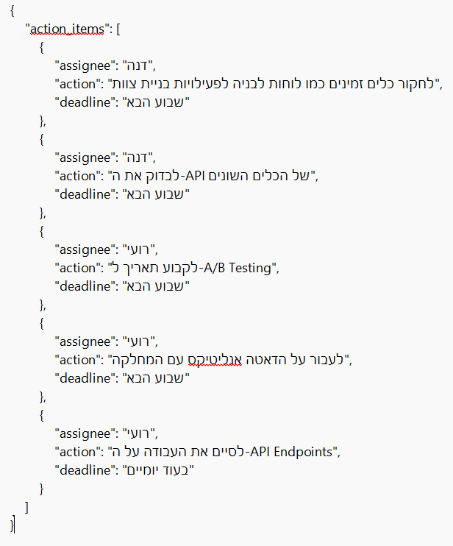
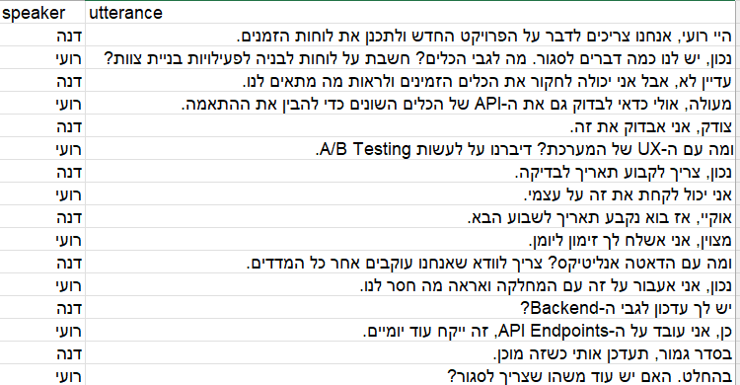
Example

Slide 7
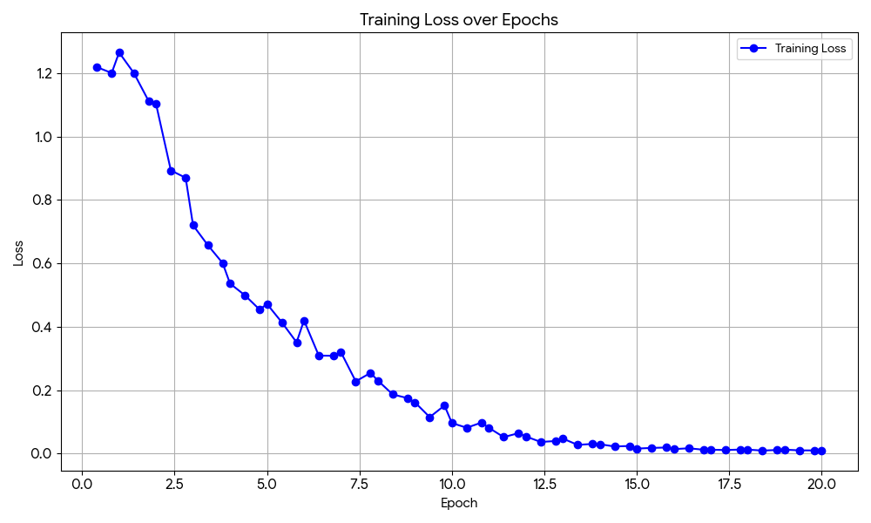
Baseline Solution & optimization
The Baseline Approach
Method: Zero-shot llama-3-8b-bnb-4bit + Hebrew-to-English Translation
Outcome: Failed to capture linguistic nuances
Semantic Similarity: Only 32.5% (Vectors were misaligned due to translation errors)
JSON Validity: 80% (Model frequently hallucinated keys or broke syntax)
The Optimization (Our Solution)
Method: Fine-Tuning with Unsloth (QLoRA) on synthetic Hebrew data
Challenge: The model suffered from "Catastrophic Forgetting" (lost JSON formatting skills)
Fix: Applied One-Shot Schema Forcing during inference

Slide 8
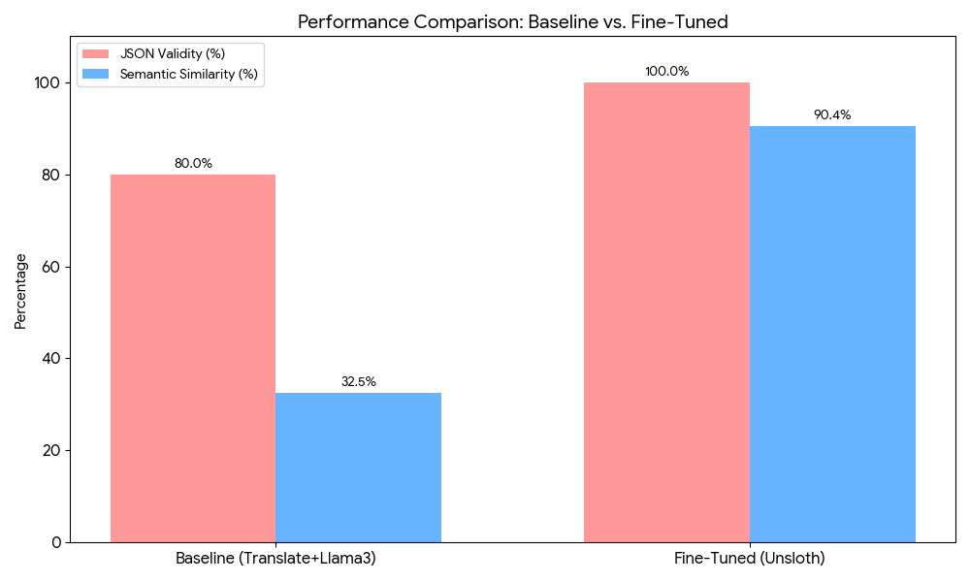
Result
Achieved SOTA performance on our dataset
JSON Validity: 100% (Perfect structural stability)
Semantic Similarity: 90.4% (High accuracy in extracting Action Items)
Significant improvement in both stability and understanding after Fine-Tuning

Slide 9
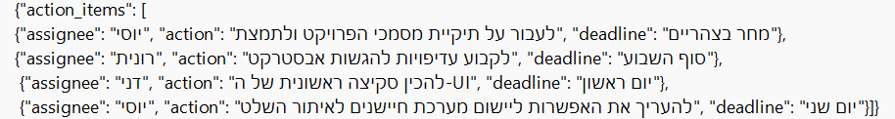
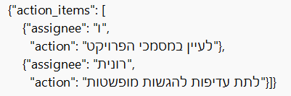
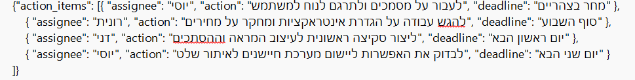
 | Expected
 | Before Fine-tuning
 | After Fine-tuning

Slide 10

Plan
Phase | Task | Expected Outcome
1. Optimization | Hyperparameter Tuning & Regularization | Experiment with different LoRA ranks and dropout rates to ensure model stability (avoiding overfitting).
2. Scale | Data Augmentation | Generate ~100 additional synthetic samples to validate robustness on a larger test set.
3. Validation | Qualitative Error Analysis | Inspect edge cases (e.g., extreme slang, empty lists) and refine the prompt strategies accordingly.
4. Submission | Final Repo & Documentation | Update repository with clean code, datasets, Visual Abstract, and a detailed README.
5. Closing | Final Presentation | Prepare the final presentation and demo for the end-of-semester class.

